Slide 1
Capstone of Jyothi LastName
Statistics & Modeling
Coding with Performance on Big Data
Communicating Results for Decision-Making
Venn Diagram of Data Science Skills

Slide 2
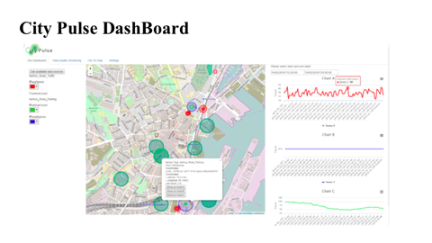
Contribution of Competitor’s Article
City Pulse project services smart city solution, by means of interpreting big data from Internet of Things and social networks. This project focus on Arhus city sensor data sources.
City Pulse dashboard is an application which visualizes traffic, parking and event information.
When a user chooses the right criteria, map will be populated with markers for each sensor along with traffic information.
On the right, domain experts can run some analytics on historic data.

Slide 3
Description of Your Contribution
Similar to City Dashboard project, we focused on city traffic information to predict future traffic conditions based on Time variant and Spatial data.
Our assumptions are, driving situations varies for different places and also different times. If we can predict these variations, most of the traffic issues could be solved.
Data filtered, formatted and aggregated within Spark framework using Zeppelin, which provides high performance and easy to use built-in infrastructure.
Created analytical charts and Heat maps. Some problematic time zones and performance bottlenecks were identified using graphs.
By using spatial data, we have applied K-means clustering algorithm to create similarity groups to recognize patterns. By using temporal data and ARIMA time series model, we estimate future traffic metrics.
Tried to create User module for frontend, using Html and JavaScript to host the application in public domain.

Slide 4
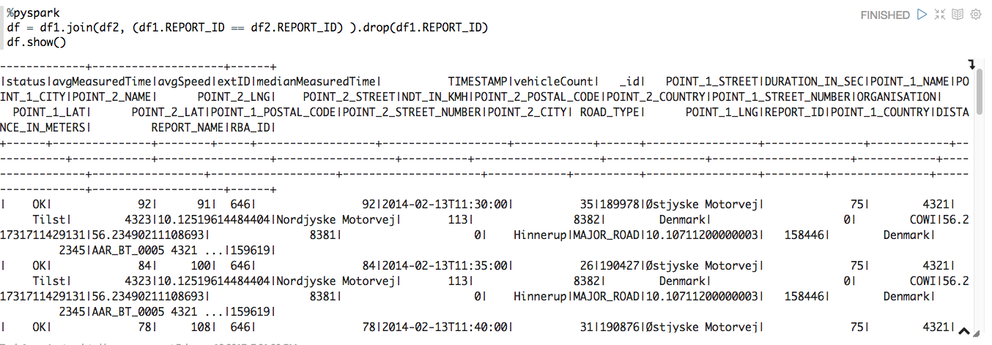
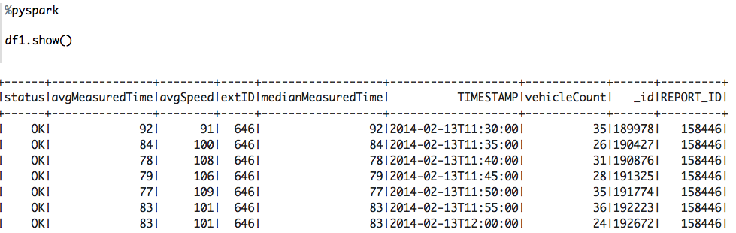
Data Source and Content
Road data consists of two different types of data files.
First type is metadata. There is a separate metadata file for each individual city.
Second type of data is street traffic data. Each file represents individual street traffic information. Each line represents traffic information for every five minutes

Slide 5
Your Method
Traffic flows are identified by three properties. Traffic speed, average time and vehicle count. Since the output result is undetermined, applying unsupervised learning is the best choice.
First step is to load data into spark data frame objects. Spark provides an automatic way of storing and parallel processing. Which makes, easy to build analytics on big data.
We aggregated data hourly, filtered by average speed and vehicle count, grouped into different time zones. We examined K-means algorithm to cluster these groups. First we find best K-value by MSE. We ran K-means with K=3, clusters created for each time zone and plotted in R, ggmap.
We have implemented ARIMA Time Series model to predict future traffic information with Time variant data. We took only one street information, ran the model and forecasted it for next month.
For development and deployment, we have used Apache Spark, Zeppelin, Python pandas, R libraries to create models and Visualizing results.

Slide 6
Quantitative Results 1
Time Series Graph for One street
Auto Correlation(ACF)
Partial Autocorrelation
Diagnostics
Forecast average speed next month

Slide 7
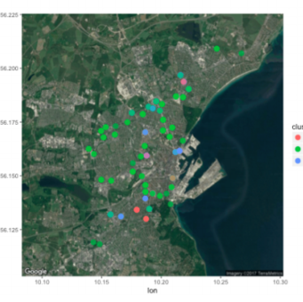
Quantitative Results 2
Average Speed and Vehicle count by hour of day
Each cell represents Average speed.
Aggregated data for clustering
K values with MSE
Plot for individual time zone.

Slide 8
Discussion: Comparison With Your Competitor
Competitor’s Results
Your Results
Aim of City Pulse is integrating heterogeneous data streams, run (near-) real-time data analytics. Based on current context of the city routing information is calculated by multidimensional weighting on path, e.g., distance, duration, pollution, events or combined metrics.
The end results provides routing information on current sensor data and run analytics on historic data.
My model extends the State of Art City pulse project, by implementing predictive modeling to find best possible routes based on Geospatial, Time variant traffic data.
We got positive results from created model, that shows us that learned clusters summarizes certain patterns in congestions, in different time-zones and at different areas
Time series analysis also provides forecasting capability of future traffic.

Slide 9
Performance on Big Data: Time Measurements
S.No | Operation | Time Measured
1 | Load raw Traffic data | Load - 41 secs( 7 million records)
2 | Load Meta data | 1 sec(500 records)
3 | Union Traffic Data Merge Meta Data | Union – 31sec Merge- data 16 sec
4 | Count Data | 1 min 35 sec(18 Million records)
5 | Aggregate by time | 2 sec
6 | Filtering and grouping data | 2 sec
7 | Save formatted data | 46sec (2 Million)
8 | load formatted data | 6min
9 | K means -15 times Plot | 6 secs(2 Million Records) 10 Secs (Plot + Map)
10 | Time series Plot | 5secs( 1 Million Records) 19secs
11 | Plot the results | Bar chart -1 min 5 sec. Heat Map -1min 20 sec

Slide 10
Conclusion
As there is exponential growth in volumes of data day by day, proper use of advanced tools like Spark, Zeppelin other advanced packages in R, Python are the some of best options to improve future of building models.
Among others, one important issue which needs to be addressed is how to identify the bottleneck of the urban street network.
Finding seasonal patterns also makes better conclusions about traffic. Fine tuning the algorithm with these bottleneck issues will result in more accurate findings.
From the results, we concluded that traffic flow data exhibits a some sort of trends and patterns.

Slide 11
Quiz for Your Classmates
What statistical method was used?
What programming tool was used?
What scientific contribution was made?

